Slide 1

BCAC 0019 Web Technology -1
Dr. KANTA PRASAD SHARMA ( K P SHARMA)
Assistant Professor,
Computer Engineering & Applications,
GLA University, Mathura

Slide 2
Syllabus

Slide 3

CSS Introduction
CSS stands for Cascading Style Sheets
CSS is the language we use to style an HTML document.
CSS describes how HTML elements should be displayed?
It can control the layout of multiple web pages all at once
External stylesheets are stored in CSS files

Slide 4
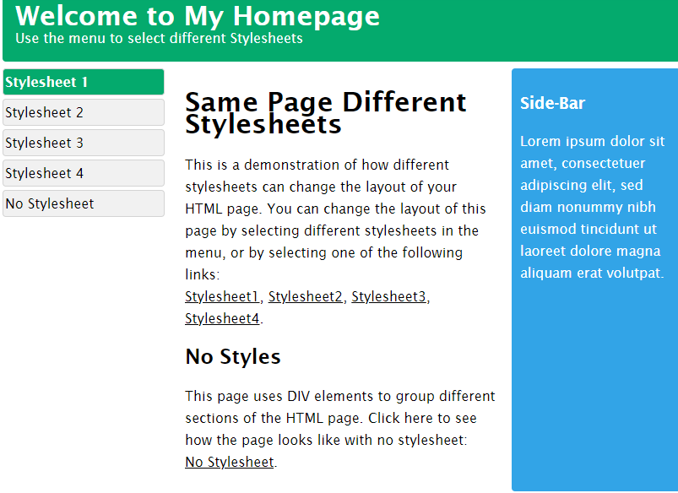
Example

Slide 5
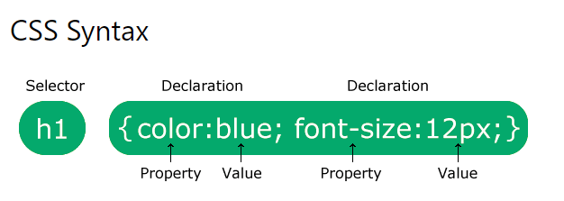
Why ???
CSS is used to define styles for your web pages,
including the design,
layout and variations in display for
different devices and screen sizes.

Slide 6
Example
html><head>
<style>
body {background-color: lightblue;}
h1 { color: white; text-align: center;}
pre { font-family: verdana; font-size: 20px;}
</style></head>
<body>
<h1>Welcome in Web Technology </h1>
<pre>SITARE U HI NHI BNTE ,
MEHNAT KRNI PDTI H </pre>
</body></html>

Slide 7
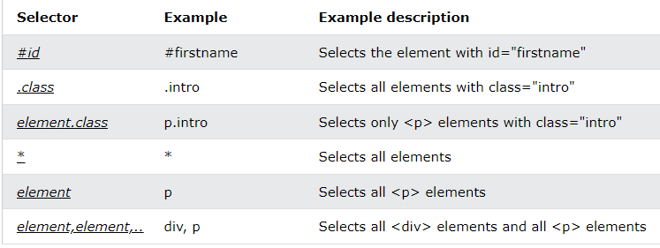
CSS SELECTORS
CSS element Selector(element name)
id Selector (#)
Class Selector (.)
Universal Selector (*)
Grouping Selector

Slide 8
CSS class Selector
CSS selectors are used to "find" (or select) the HTML elements you want to style.
We can divide CSS selectors into five categories:
Simple selectors (select elements based on name, id, class)
Combinator selectors (select elements based on a specific relationship between them)
Pseudo-class selectors (select elements based on a certain state)
Pseudo-elements selectors (select and style a part of an element)
Attribute selectors (select elements based on an attribute or attribute value)
To select elements with a specific class, write a period (.) character, followed by the class name.
.center { text-align: center; color: red; }

Slide 9
CSS class Selector
only <p> elements with class="center" will be red and center-aligned:
p { color: red; text-align: center; }
p is a selector in CSS.
color → property, and red → value.
text-align → property, and center→value.

Slide 10
CSS element Selector
<html>
<head>
<style>
.aa {
text-align: center;
color: red;
}
</style>
</head>
<body>
<p class=“aa”>Welcome<br>
<pre> hello india </pre>
<h1> Diwali</h1>
</p>
<p id="para1">Me too!</p>
<p>And me!</p>
</body>
</html>
all <p> elements on
p { text-align: center; color: red; }

Slide 11
CSS id Selector
The id selector uses the id attribute of an HTML element to select a specific element.
The id of an element is unique within a page,
So, the id selector →select one unique element!
To select an element with a specific id, write a hash (#) character,
followed by the id of the element.
#para1
{ text-align: center; color: red; }

Slide 12
<html>
<head>
<style>
#para1
{
text-align: center;
color: red;
}
</style>
</head>
<body>
<p id="para1">Hello Pranjal!</p>
<p>Welcomes in Warm Morning</p>
</body>
</html>

Slide 13
Universal Selector (*)
<html<head>
<style>
* {
text-align: center;
color: blue;
}
</style>
</head>
<body>
<h1>Hello world!</h1>
<p>BCA I YEAR STUDENTS ARE ROCKING.</p>
<p id="para1">You!</p>
<p>And us!</p>
</body></html>

Slide 14
Add CSS
When a browser reads a style sheet, it will format the HTML document according to the information in the style sheet.
Three Ways to Insert CSS
External CSS
Internal CSS
Inline CSS

Slide 15
External CSS
Hello.html
<html> <head> <link rel="stylesheet" href="mystyle.css"> </head> <body> <h1>Lets Play</h1> <p>with CSS </p> </body> </html>
mystyle.css
body
{ background-color: lightblue; } h1
{ color: red; margin-left: 20px; }

Slide 16
Internal CSS & INLINE CSS
Inside the <style> element
<html> <head> <style> body
{ background-color: linen; } h1 { color: maroon; margin-left: 40px; } </style> </head> <body> <h1>You are doing external ordinary work</h1> <p>impressive class </p> </body> </html>
use inline styles, add the style attribute to the relevant element
<!DOCTYPE html> <html> <body> <h1 style="color:blue;text-align:center;">This Class is very Good </h1> <p style="color:red;“>Students are so nice</p> </body> </html>

Slide 17
Cascading Order
All the styles in a page will "cascade" into a new "virtual" style sheet.
by the following rules, where number one has the highest priority:
Inline style (inside an HTML element)
External and internal style sheets (in the head section)
Browser default

Slide 18
COLORS in CSS
<!DOCTYPE html>
<html>
<body>
<h1 style="background-color:Tomato;">Rahul</h1>
<h1 style="background-color:Orange;">Anjali</h1>
<h1 style="background-color:DodgerBlue;">Joker</h1>
<h1 style="background-color:MediumSeaGreen;">Shyam</h1>
<h1 style="background-color:Gray;">Cherry</h1>
<h1 style="background-color:SlateBlue;">Ronaldo</h1>
<h1 style="background-color:Violet;">Mohan</h1>
<h1 style="background-color:LightGray;">Pranjal</h1>
</body>
</html>

Slide 19
CSS Backgrounds
body
{ background-image: url("paper.gif"); }
background-color
background-image
background-repeat
background-attachment
background-position
background (shorthand property)
body
{ background-color: lightblue; }
p { background-image: url("paper.gif"); }

Slide 20
<!DOCTYPE html>
<html>
<head>
<style>
body {
background-image: url("gradient_bg.png");
background-repeat: repeat-x;
}
</style>
</head>
<body>
<h1>Hello World!</h1>
<p>horizontally!</p>
</body>
</html>
<!DOCTYPE html>
<html>
<head>
<style>
p {
background-image: url("paper.gif");
}
</style>
</head>
<body>
<h1>Hello World!</h1>
<p>This paragraph has an image as the background!</p>
</body>
</html>
body
{ background-image: url("gradient_bg.png"); background-repeat: repeat-x; }

Slide 21
Create a Font Class
.css-sofia
{ font-family: Sofia, cursive;
}
.w3-tangerine
{ font-family: 'Tangerine', serif;
}
family=Lobster
family=Tangerine

Slide 22
Round Classes
w3-roundElement rounded (border-radius)
4pxw3-round-smallElement rounded (border-radius)
2pxw3-round-mediumElement rounded (border-radius)
4pxw3-round-largeElement rounded (border-radius)
8pxw3-round-xlargeElement rounded (border-radius)
16pxw3-round-xxlargeElement rounded (border-radius) 32px

Slide 23
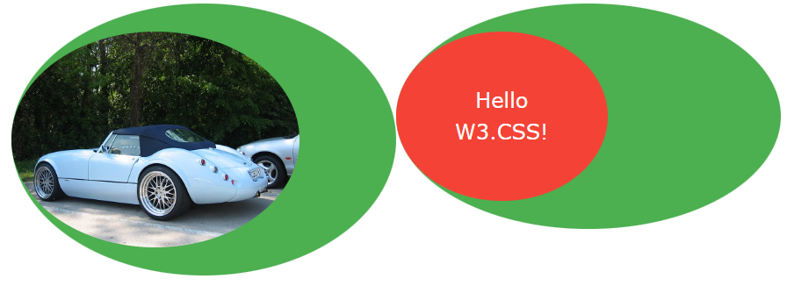

Slide 24
CSS Padding Number Classes
ClassDefinesw3-padding-16Adds 16px top and bottom padding to an element
w3-padding-24Adds 24px top and bottom padding to an element
w3-padding-32Adds 32px top and bottom padding to an element
w3-padding-48Adds 48px top and bottom padding to an element
w3-padding-64Adds 64px top and bottom padding to an element

Slide 25
Padding Example
<html>
<title>Padding Style</title>
<meta name="viewport" content="width=device-width, initial-scale=1">
<link rel="stylesheet" href="https://www.w3schools.com/w3css/4/w3.css">
<body>
<div class="w3-container">
<div class="w3-panel w3-padding-16 w3-green">
<h4>Enjoy Cooling weather </h4>
<p>Hello India </p>
</div>
<div class="w3-panel w3-padding-24 w3-orange">
<h4>Life is too smart</h4>
<p>Value your time </p>
</div>
<div class="w3-panel w3-padding-32 w3-orange">
<h4>Respect your Parents Always </h4>
<p>Respect your friends , They Respect you/p>
</div>
<div class="w3-panel w3-padding-48 w3-orange">
<h4>No one Alone in this world</h4>
<p>Have beautiful dreams in your Eyes</p>
</div>
<div class="w3-panel w3-padding-64 w3-orange">
<h4>Fight with yourself onyly</h4>
<p>Did you have your principles</p>
</div>
</div>
</body></html>

Slide 26
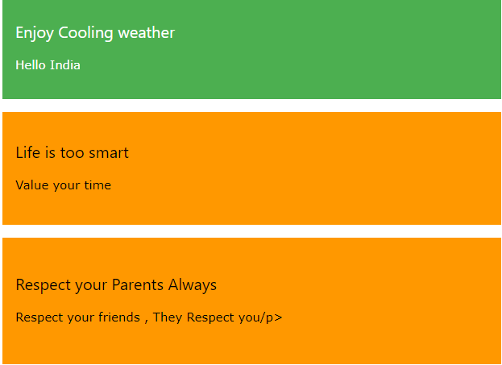
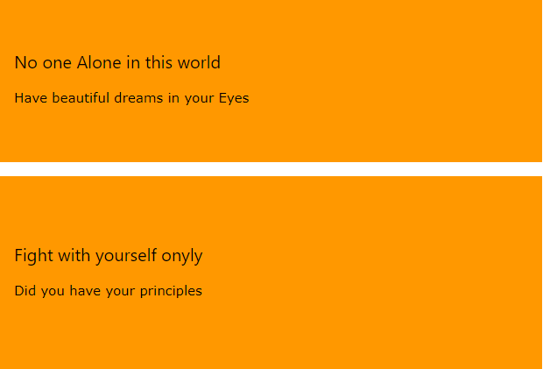
Outputs

Slide 27
CSS Border Style
The border-style property specifies what kind of border to display.
dotted - Defines a dotted border
dashed - Defines a dashed border
solid - Defines a solid border
double - Defines a double border
groove - Defines a 3D grooved border. The effect depends on the border-color value
ridge - Defines a 3D ridged border. The effect depends on the border-color value
inset - Defines a 3D inset border. The effect depends on the border-color value
outset - Defines a 3D outset border. The effect depends on the border-color value
none - Defines no border
hidden - Defines a hidden border

Slide 28
Syntax
p.dotted {border-style: dotted;} p.dashed {border-style: dashed;} p.solid {border-style: solid;} p.double {border-style: double;} p.groove {border-style: groove;} p.ridge {border-style: ridge;} p.inset {border-style: inset;} p.outset {border-style: outset;} p.none {border-style: none;} p.hidden {border-style: hidden;} p.mix {border-style: dotted dashed solid double;}

Slide 29
Example
<html><head>
<style>
p.dotted {border-style: dotted;}
p.dashed {border-style: dashed;}
p.solid {border-style: solid;}
p.double {border-style: double;}
p.groove {border-style: groove;}
p.ridge {border-style: ridge;}
p.inset {border-style: inset;}
p.outset {border-style: outset;}
p.none {border-style: none;}
p.hidden {border-style: hidden;}
p.mix {border-style: dotted dashed solid double;}
</style>
</head>
<body>
<h2>The best class </h2>
<p>Hello India</p>
<p class="dotted">FIP</p>
<p class="dashed">A Well dressed class</p>
<p class="solid">students have solid brain</p>
<p class="double">My students have innovative ideas</p>
<p class="groove">A grooming class of BCA </p>
<p class="ridge">a health discussion and motivate students</p>
<p class="inset">friendly class environment</p>
<p class="outset">class have have eco friendly behavior</p>
<p class="none">No boundary for new ideas</p>
<p class="hidden">Students have deep knowledge.</p>
<p class="mix">A impressive class</p>
</body></html>

